Slide 1
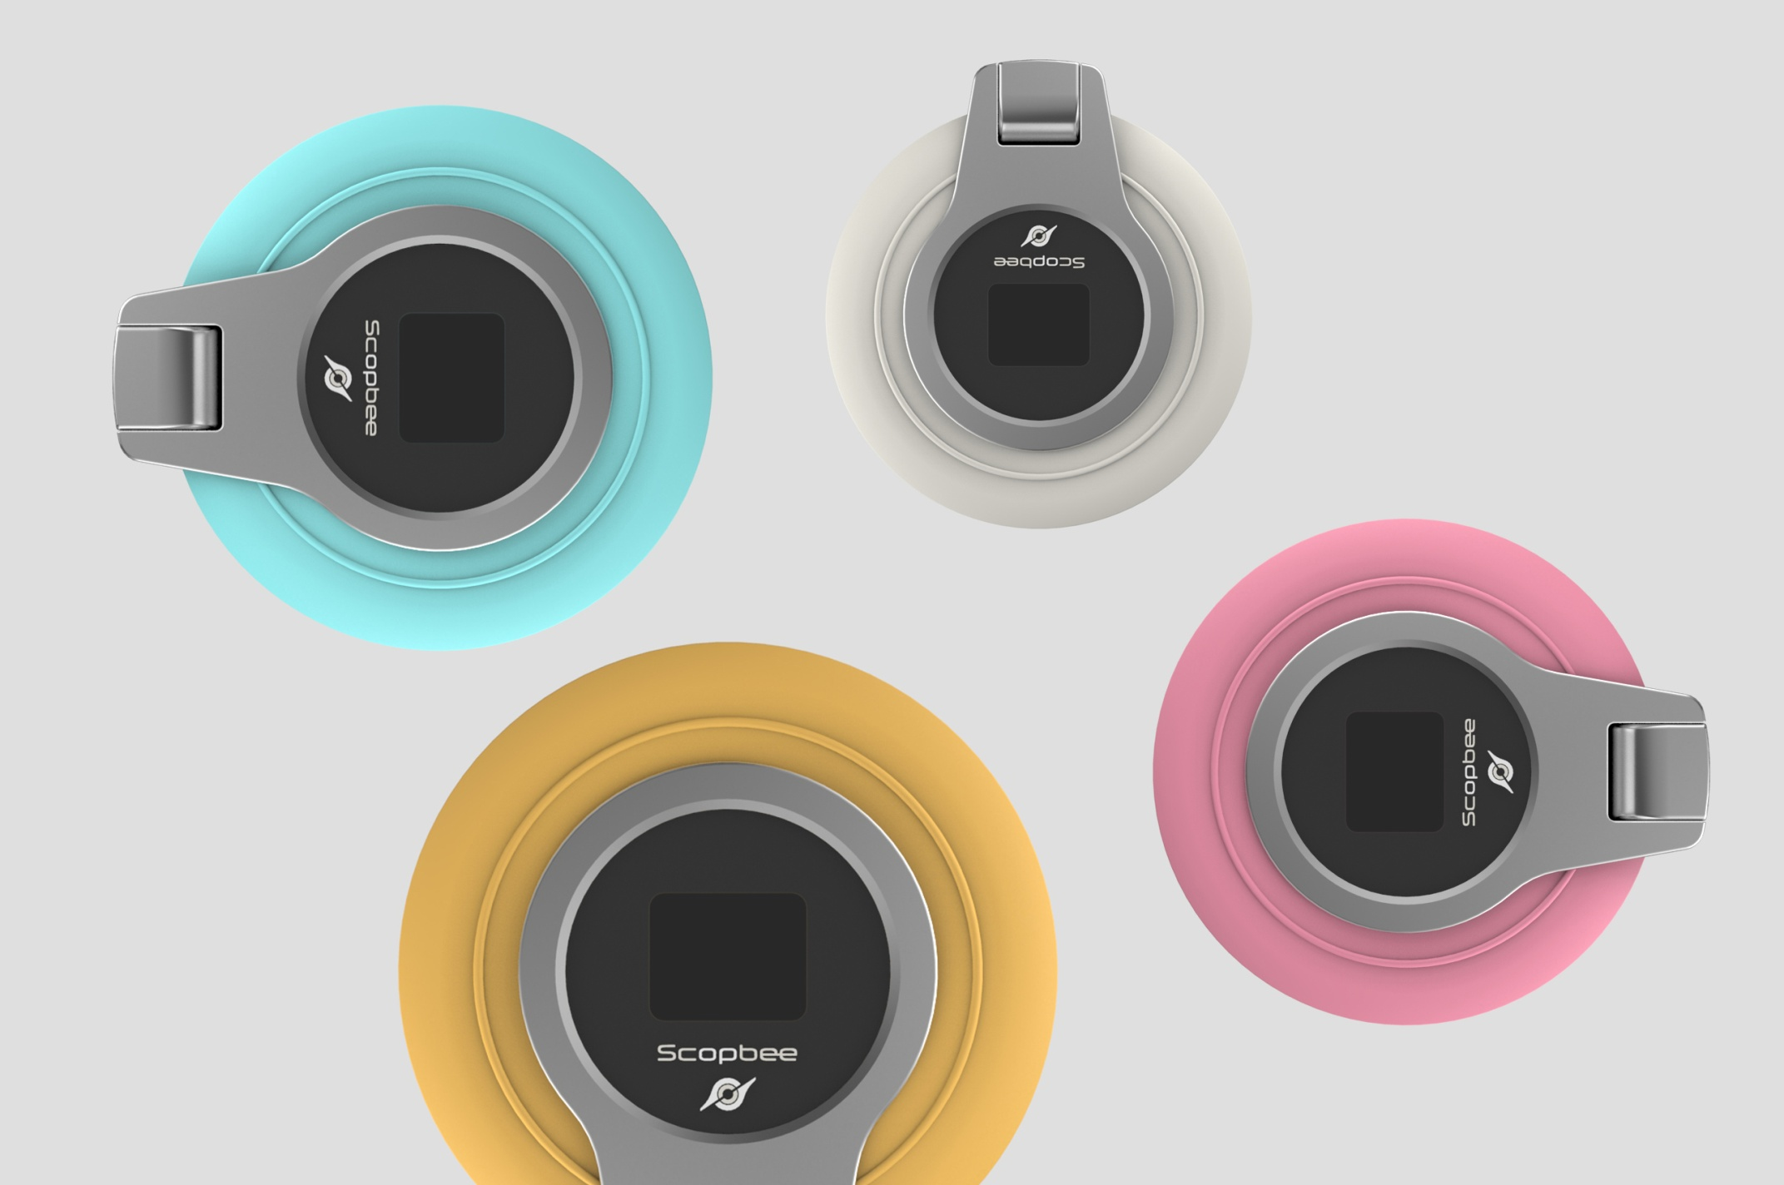

SCOPBEE 360
Affordable Price to Get 360° Life

Slide 2

SCOPBEE 360
Record Outdoor Activities Easily

Slide 3
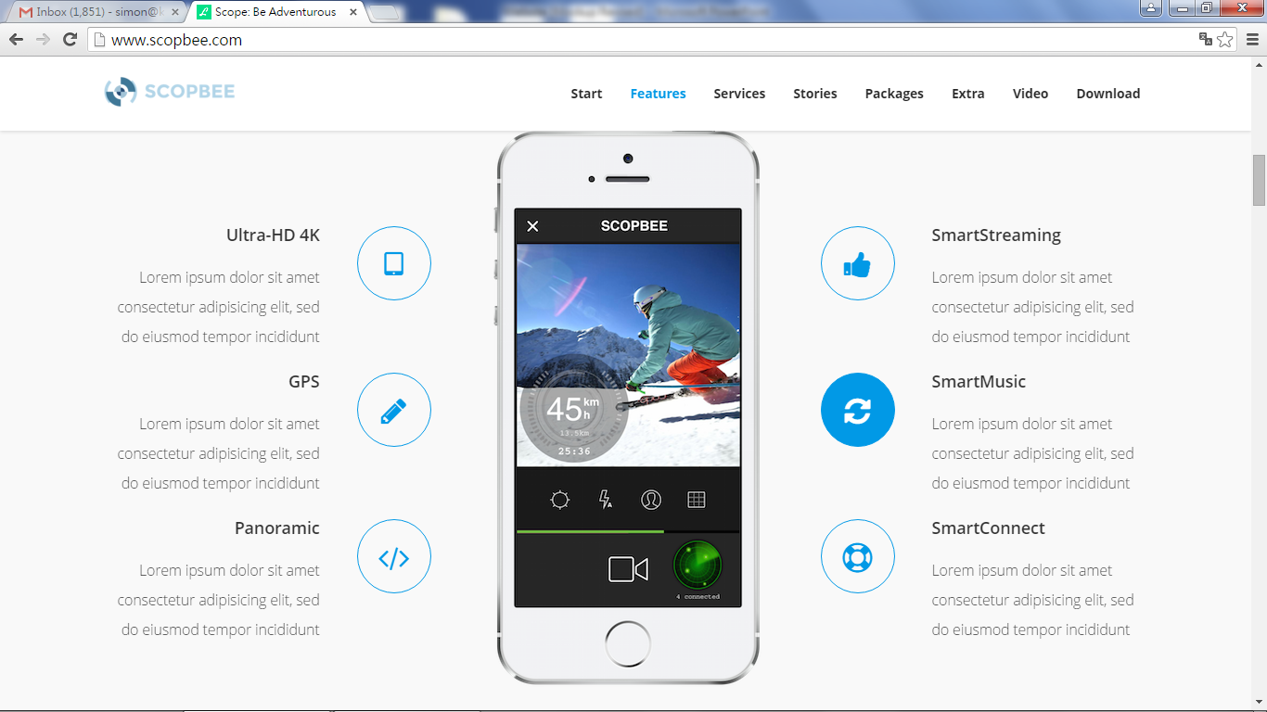
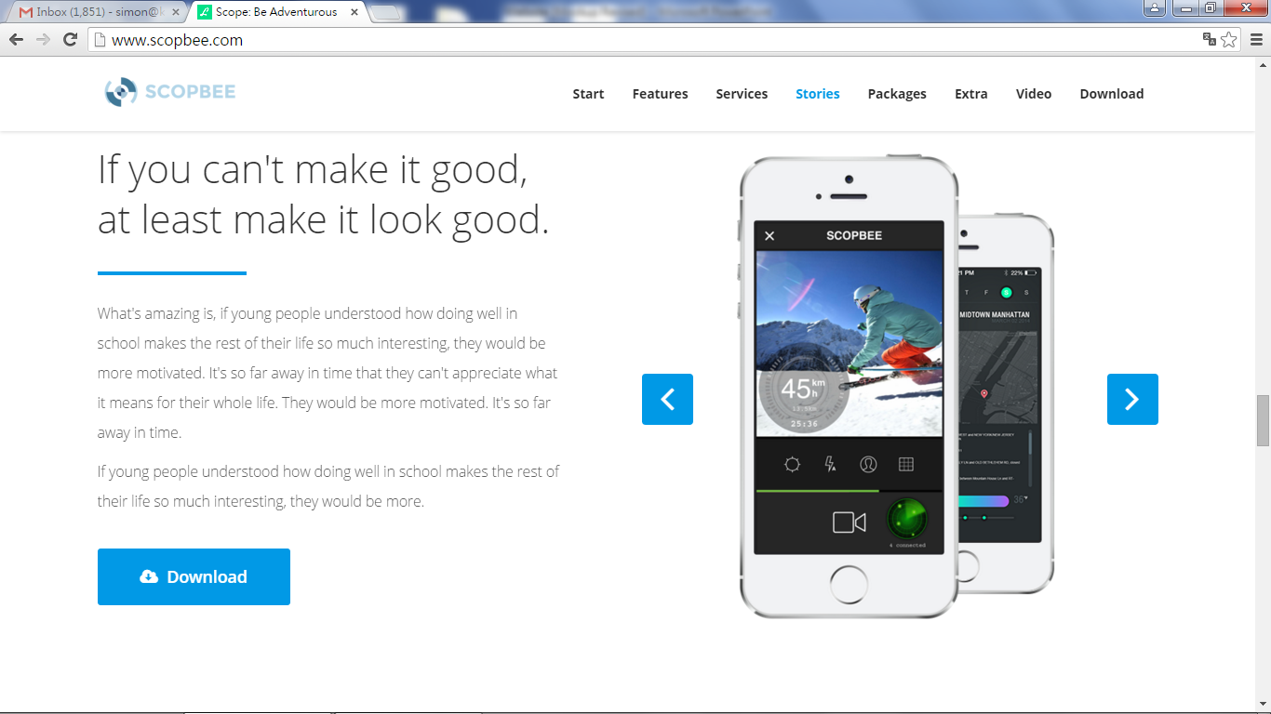

Slide 4
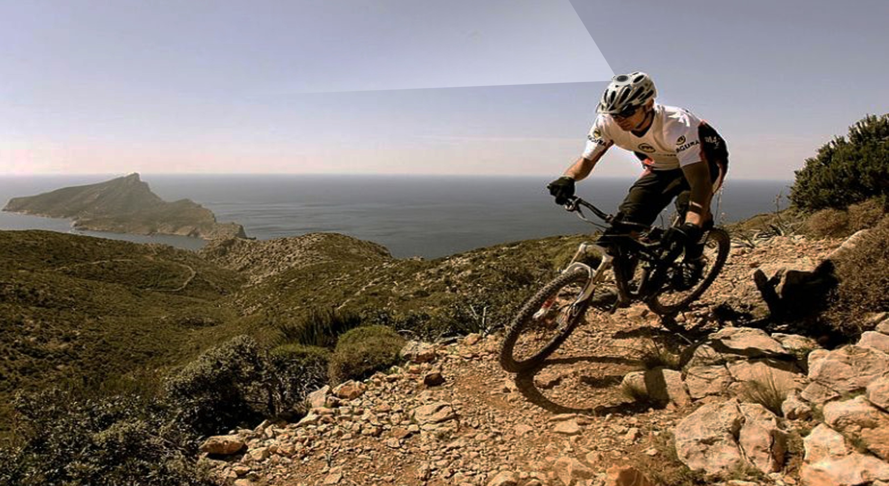
SCOPBEE 360
Record Glorious Time Safely

Slide 5

SCOPBEE 360
Take Magnificent Picture Simply

Slide 6
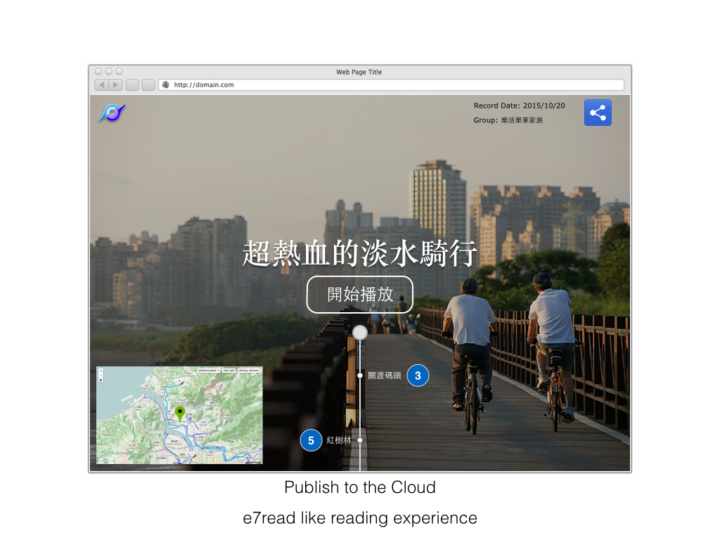
SCOPBEE 360
Joining and Sharing

Slide 7
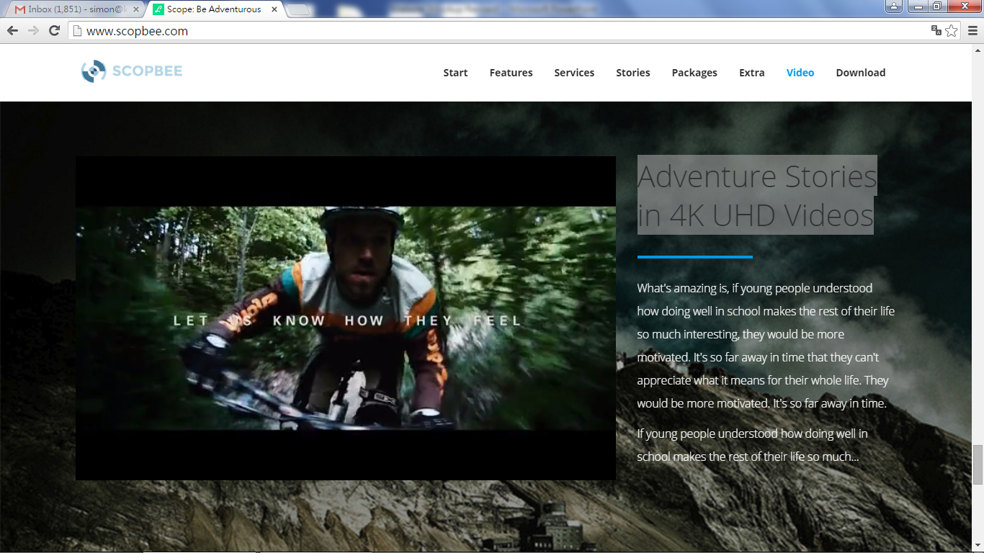

Slide 8
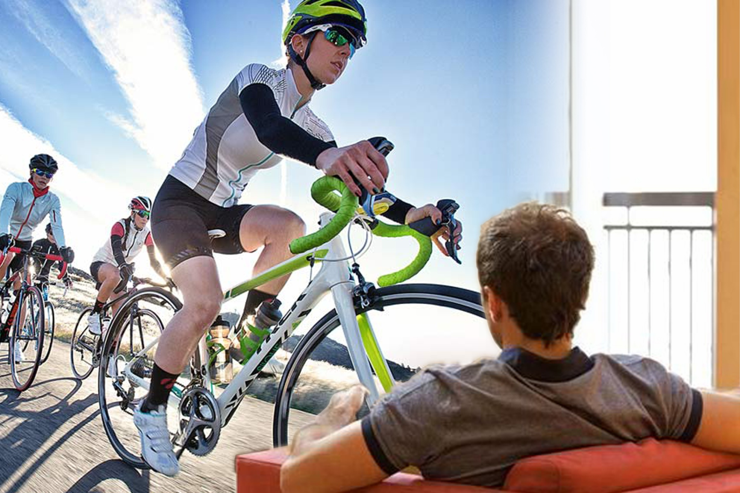
SCOPBEE 360
Never Absent, Always Present

Slide 9
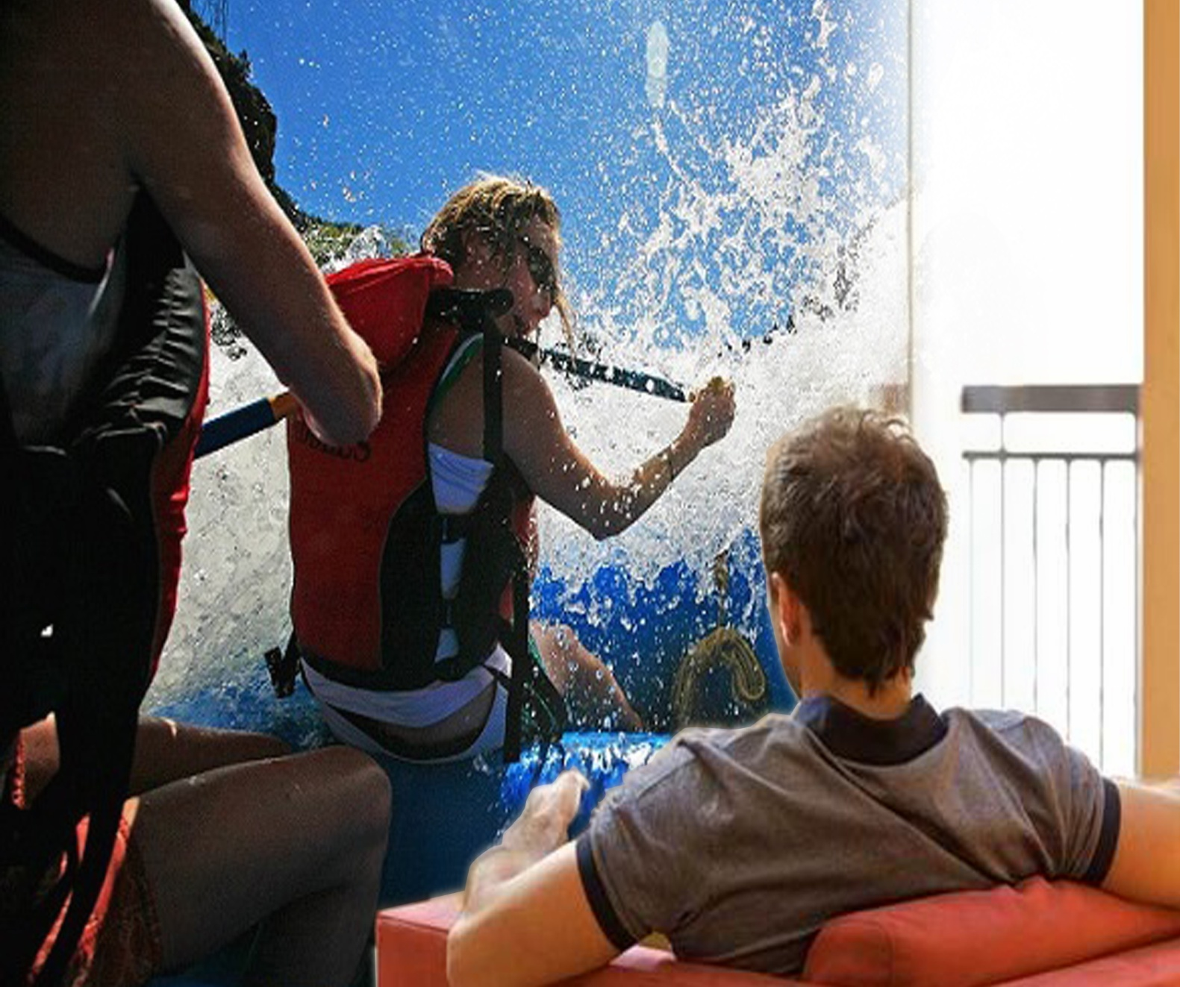
SCOPBEE 360
As a TEAM, Been There, Done That!

Slide 10
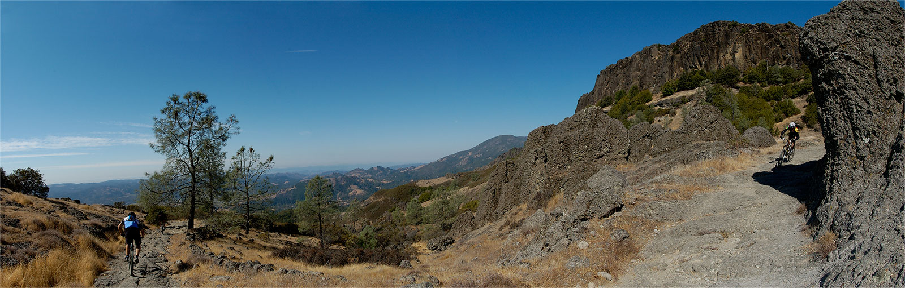
Scopbee, 360° Life!

